Slide 1
PredictiveObject Tracking
Simulation software

Slide 2
Our Team
DÁNIEL BÁLINT
ÁDÁM VERASZTÓ
BENEDEK KÖRNYEI
Software, Documantation,
Presentation
Software GUI,
Software Logic
Sofware,
Documantation

Slide 3
Software Architecture
Data Processing Module
Object Tracking Model
GUI
Displaying visual artifacts
Indicating sensor values
Blind Spot Alarm
Start/Stop simulation
Load sensor data
Parse and pre-filter data
Init data structures
Updating object params based on sensed data
Filtering
Estimating next state

Slide 4
Control flow
Preprocessing
Datasets
Loading and filtering sensor data
Updating Object Pool (Filter)
New object pool
Object Predictions
GUI Blind spot Alarm

Slide 5
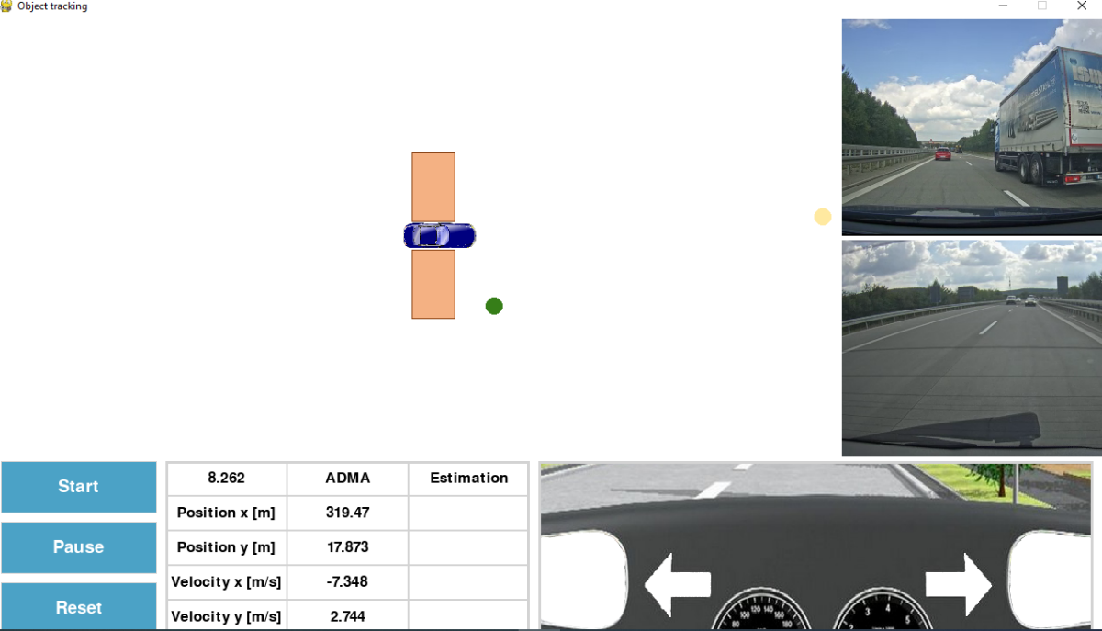
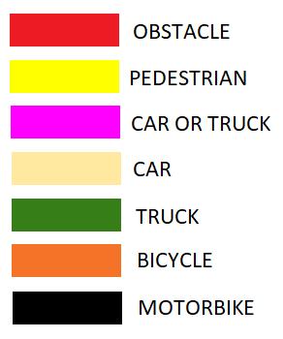
Graphical User Interface

Slide 6


Ideas, Future Projects
Lane change assistance
Convoy Of Self-Driving Trucks
Self-Driving Trucks follow eachother
Tracked object collision emergency
New feature which can detect other vehicles’ collision, accident

Slide 7
THANK YOU FOR YOUR ATTENTION!
Do you have any questions?
Please keep this slide for attribution.

